Slide 1
Linux

Slide 2
Agenda:
What is Linux? Linux VS Unix
Components of Linux Linux VS Windows
What is GNU GPL?
History of Linux
Use of Linux
Popular variants of Linux
What is Kernel?
What is a Linux Shell?
Architecture of Linux Operating System
User Space and Kernel Space
Advantages of Linux
Features of Linux

Slide 3
What is Linux?

Slide 4
Linux:
Linux is an open-source operating system that is based on the principles of the Unix architecture.
It acts as a bridge between computer hardware and software, enabling various applications to run smoothly while managing system resources such as memory, processing power, and storage.
Linux’s Open Source Nature:
What makes Linux unique is its open-source nature, meaning its source code is freely available for anyone to view, modify, and distribute.
This has fostered a vibrant community of developers who contribute to its growth and customization.

Slide 5
Linux:
Features of Linux being Open-Source:
Transparency.
Customization.
Community Contributions.
Free Distribution.
Adaptable.
Affordable.

Slide 6
Components of Linux

Slide 7
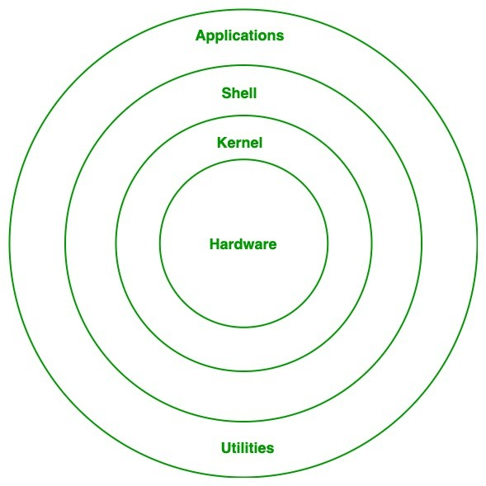
Components of Linux:
Kernel:
The core part of Linux.
It directly interacts with hardware and manages system resources like memory, CPU, and devices.
Handles low-level tasks such as process management and device drivers.

Slide 8
Components of Linux:
System Libraries:
These are special programs that provide functionality to the system and applications.
They enable software and applications to communicate with the kernel without needing detailed hardware knowledge.
Example: GNU C Library (glibc).

Slide 9
Components of Linux:
System Utilities:
Basic tools and commands for managing the system.
Includes utilities for file manipulation, program execution, and user management.
Examples: ls, mv, etc.

Slide 10
Components of Linux:
Shell:
A command-line interpreter that allows users to interact with the Linux system.
Can execute commands, scripts, and manage tasks.
Examples: Bash (Bourne Again Shell), Zsh (Z Shell).

Slide 11
Components of Linux:
Applications:
Various software that runs on top of Linux.
This could include productivity tools, development environments, or server applications.

Slide 12
GNU GPL

Slide 13

GNU GPL:
The GNU General Public License (GPL) is one of the most widely used free software licenses, created by Richard Stallman and the Free Software Foundation (FSF).
It is designed to guarantee users the freedom to use, study, modify, and distribute software.

Slide 14
GNU GPL:
Key Features of GNU GPL:
Freedom to Use.
Access to Source Code.
Permission to Modify.
Freedom to Share.

Slide 15
GNU GPL:
Key Features of GNU GPL:
Copyleft Provision:
The GPL uses a concept called "copyleft," which ensures that any modified or derived software must also be distributed under the same GPL license. This prevents the software from being turned into proprietary products.

Slide 16
History of Linux

Slide 17
History of Linux:
Year | Event | Description
1991 | The Birth of Linux | Linux was created by Linus Torvalds, a Finnish computer science student. Torvalds initially developed it as a personal project to build a free operating system kernel inspired by MINIX (a Unix-like OS). On August 25, 1991, Linus announced his project on the comp.os.minix forum, inviting others to contribute.
1992 | Open-Source Licensing | Linux was released under the GNU General Public License (GPL), making it free and open for modification and redistribution. This fostered global collaboration and development.

Slide 18
History of Linux:
Year | Event | Description
Mid-1990s | Development of Distributions | The first Linux distributions, such as Slackware and Debian, were created to package the kernel with user-friendly tools and applications. These distributions made Linux accessible to a wider audience.
Late 1990s | Expansion to Servers | Linux gained popularity in server environments due to its stability and performance. Major companies like IBM and Oracle began supporting Linux.

Slide 19
History of Linux:
Year | Event | Description
2000s | Growth in Consumer Usage | User-friendly distributions like Ubuntu made Linux more accessible for personal computing. It began to be adopted by hobbyists, developers, and enterprises.
2008 and Beyond | Linux in Mobile and Embedded Systems | Android, based on the Linux kernel, revolutionized the mobile industry and became the world's most-used operating system. Linux also became dominant in embedded systems and IoT devices.

Slide 20
Uses of Linux

Slide 21
Uses of Linux:
Usage | Description
Web Servers | A significant majority of web servers around the world run on Linux. Examples: Popular distributions like CentOS and Ubuntu are commonly used in hosting websites.
Personal Desktops and Laptops | Linux distributions such as Ubuntu, Mint, and Fedora are widely used for personal computing, offering a secure and customizable alternative to proprietary operating systems.
Supercomputers | Nearly all supercomputers in the world use Linux due to its scalability, stability, and performance.

Slide 22
Uses of Linux:
Usage | Description
Embedded Systems | Linux powers a variety of embedded systems, such as routers, TVs, automotive systems, and home automation devices.
Mobile Devices | Android, a widely used mobile operating system, is built on the Linux kernel.
Cloud Computing and Data Center | Linux is the backbone of many cloud services and virtualized environments, including major platforms like AWS, Microsoft Azure, and Google Cloud.

Slide 23
Uses of Linux:
Usage | Description
Programming and Development | Linux provides a robust environment for developers, offering tools and platforms for software development, testing, and deployment.
Educational and Research Environments | Linux is popular in academic and research settings, offering cost-effective and flexible solutions for computer labs and experiments.
Gaming | With the rise of platforms like SteamOS (based on Linux), gaming on Linux has become more accessible and widely adopted.

Slide 24
Popular Variants of Linux

Slide 25
Popular Variants of Linux:
Linux has numerous variants, or distributions, tailored to different user needs. These distributions package the Linux kernel with system utilities, libraries, and applications, providing a complete operating system experience. A few examples are:
Ubuntu Kali Linux
Fedora Linux Mint
Debian Red Hat Enterprise Linux (RHEL)
CentOS OpenSUSE
Arch Linux

Slide 26
What is Kernel?

Slide 27
What is Kernel?
The kernel is the core and foundational component of the Linux operating system.
It acts as a bridge between software applications and the hardware of a computer, ensuring smooth communication and efficient resource management.
Functions of the Kernel:
Resource Management: Manages CPU, memory, and storage, allocating them to different processes as needed.
Hardware Interaction: Acts as an intermediary between hardware devices and software applications.
Process Control: Handles the execution of processes, multitasking, and scheduling.
System Security: Protects data and ensures secure communication within the system.

Slide 28
What is a Linux Shell?

Slide 29
What is a Linux Shell?
A Linux Shell is a command-line interface that acts as an intermediary between the user and the Linux operating system.
It allows users to interact with the system by entering commands, which the shell interprets and passes to the kernel for execution.
Key Features of a Linux Shell:
Command Interpretation.
Scripting Capabilities.
Customizability.

Slide 30
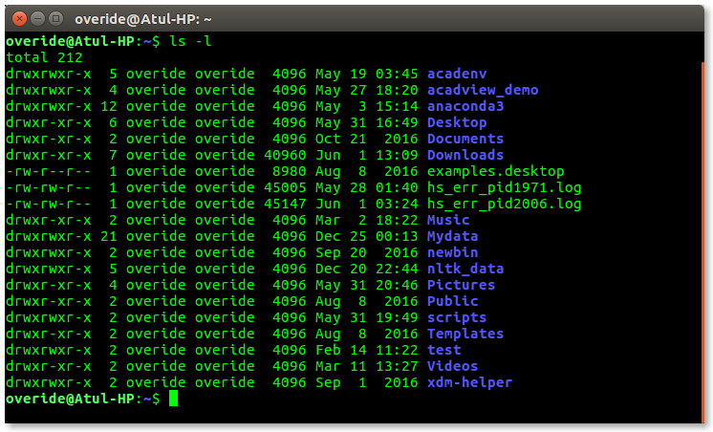
What is a Linux Shell?

Slide 31
Architecture of Linux Operating System

Slide 32
Architecture of Linux Operating System:
Layer | Description
Hardware Layer | This is the physical layer that includes the computer's hardware components, such as the CPU, memory, and storage devices.
Kernel Layer | The core part of Linux, responsible for managing hardware and system resources. Functions: Process management, memory management, device control, and system security.
System Libraries Layer | Contains libraries that provide functionalities for software applications. Example: GNU C Library (glibc) enables interaction with the kernel.

Slide 33
Architecture of Linux Operating System:
Layer | Description
System Utilities Layer | Includes basic tools and programs that allow users to perform system-related operations, such as file management and process control.
User Space Layer | Includes all applications and programs run by users. Provides an environment for user interfaces, graphical user interfaces (GUIs), and shell interactions.

Slide 34
Architecture of Linux Operating System

Slide 35
User Space and Kernel Space

Slide 36
User Space and Kernel Space:
Aspect | Kernel Space | User Space
Definition | The memory space where the core of the operating system (kernel) operates. | The memory space where user applications and processes run.
Access Level | Limited access, restricted to ensure system security and stability. | Has privileged access to all hardware resources and system processes.
Operations | Executes high-level tasks such as running applications and user programs. | Performs low-level operations such as device management and system calls.
Memory Protection | Isolated from kernel space to avoid interference with critical functions. | Protected from unauthorized access, ensuring stability and preventing errors.

Slide 37
User Space and Kernel Space:
Aspect | Kernel Space | User Space
Examples | Device drivers, process scheduler, memory manager. | Applications like web browsers, media players, and user-created scripts.
Interaction | Communicates with User Space via system calls (e.g., file operations). | Relies on system calls to interact with Kernel Space (e.g., accessing hardware).
Data Handling | Directly manages hardware-level data such as I/O and memory allocation. | Handles user data and interacts with files or network resources indirectly.
Crash Impact | Errors in Kernel Space can lead to system-wide crashes. | Errors in User Space generally affect only the specific application or process.

Slide 38
Advantages of Linux

Slide 39
Advantages of Linux:
Open Source.
Low Cost.
Stability and Reliability.
Security.
Performance.
Customizability.
Versatility.
Hardware Compatibility.

Slide 40
Features of Linux

Slide 41
Features of Linux:
Open Source. Performance Optimization.
Multi-User Support. Software Repository.
Multi-Tasking. Virtualization.
Portability.
Security.
Stability.
Shell Interface.
Hardware Compatibility.
File System Support.
Modularity

Slide 42
Linux VS Windows

Slide 43
Linux vs Windows:
Aspect | Linux | Windows
Source Code | Open-source: Source code is publicly available and modifiable. | Closed-source: Proprietary code owned by Microsoft.
Cost | Free (most distributions) or minimal costs for enterprise versions. | Generally requires a purchased license for use.
Customizability | Highly customizable: Users can modify the OS and its appearance. | Limited customization options compared to Linux.
User Interface | Offers both GUI and CLI (e.g., GNOME, KDE, terminal). | Primarily GUI, with some CLI options via Command Prompt or Power-Shell.

Slide 44
Linux vs Windows:
Aspect | Linux | Windows
Security | More secure due to user permissions and open-source scrutiny. | Regularly targeted by malware and viruses; requires antivirus software.
Performance | Lightweight; efficient even on older hardware. | Heavier resource usage, especially in newer versions.
File Systems | Supports Ext2/Ext3/Ext4, Btrfs, XFS, etc. | Uses NTFS, FAT32, and exFAT.
Software Compatibility | Supports open-source applications; limited for some proprietary software. | Supports a wide range of proprietary software and applications.

Slide 45
Linux vs Windows:
Aspect | Linux | Windows
Stability | Extremely stable, especially for servers and long-term use. | Stable, but can experience issues with updates or resource-heavy applications.
Community Support | Strong online communities and forums for troubleshooting. | Official support via Microsoft and third-party services.
Learning Curve | Steeper for beginners; requires familiarity with command-line tools. | Easier for beginners, with a user-friendly GUI interface.
Use Cases | Ideal for servers, programming, embedded systems, and advanced users. | Preferred for gaming, business applications, and personal desktops.

Slide 46
Linux VS Unix

Slide 47
Linux vs Unix:
Aspect | Linux | Unix
Source Code | Open-source: Source code is publicly available and modifiable. | Closed-source; proprietary versions exist (e.g., IBM AIX, HP-UX, Solaris).
Cost | Free (most distributions) or minimal costs for enterprise versions. | Expensive; licensing fees apply for proprietary Unix versions.
Customizability | Highly customizable: Users can modify the OS and its appearance. | Limited customizability; source code is often not available for modification.
Origin | Created by Linus Torvalds in 1991. | Developed in the 1970s at AT&T Bell Labs by Ken Thompson, Dennis Ritchie, and others.

Slide 48
Linux vs Unix:
Aspect | Linux | Unix
Security | More secure due to user permissions and open-source scrutiny. | Secure, but often reliant on proprietary updates and patches.
Performance | Lightweight; efficient even on older hardware. | Optimized for stability and performance in large-scale server and enterprise environments.
File Systems | Supports Ext2/Ext3/Ext4, Btrfs, XFS, etc. | Supports fewer file systems, usually those specific to the Unix version.
Compatibility | Runs on a wide variety of hardware, from personal computers to servers and embedded systems. | Primarily designed for servers and high-end systems; hardware-specific.

Slide 49
Thank You!
- Nisanth Saravanan.

